Slide 1




FUTSA
A FUTSAL BOOKING SYSTEM
Supervised by Members
Mohammad Sir Saroj Poudel [19180080]
Sandesh Thapa [19180076]
Saroj Aryal [19180079]
Rikesh Baniya [19180070]

Slide 2

Abstract
FUTSA is a technical way of managing the futsal booking process.
Convenient way of finding and booking Futsal anywhere anytime .
Easiest and effectively managed booking system.

Slide 3
Introduction
FUTSA is a web-based booking System.
Informative, user-friendly digitized system.
Managing Schedule is Easy and Fast.
Time convenient Booking System.
Notes:
Big data is a fast emerging topic among both industry and academia, it is featured by 3Vs: Volume, Variety and Velocity. Volume is size of data. Variety is different type of data industry generating i.e. structured, semi-structured and unstructured. Velocity is the speed data is generating. The main challenge for big data is that how to extract required information within given time limit.
Therefore, several big data processing tools emerge, like Hadoop[1] and Storm. Hadoop is mostly used for off-line data processing, whereas Storm is adequate for on-line stream process. Nowadays,more data-intensive applications and technologies require online massive data processing instead of traditional store then-process system with minimum latency.

Slide 4
Background
Booking Futsal is sometimes a troublesome task.
We might not know where the futsal is located also maynot be available according our to desired time table.
The match fees it is going to cost us and various other informations are not constant everywhere.
So, we aim to build this Web App which will provide us various locations, fees, schedule a match of futsal with which we can compare and make best decision possible to book a futsal.

Slide 5
Problem Statement
Unreliable manual booking system.
Booked schedule were not followed strictly.
Problem in availability and schedule of Futsal.
Disproportionate rates of futsals .
Difficulty in finding the exact location of Futsals located at different corners.

Slide 6
Objectives
To eradicate complicated phone based booking processes.
To provide the available playing time accurately.
To enable customers book the futsal time remotely
Transparent and Uniform Match Fee.
To find all the futsal located in your area.

Slide 7


Related Work ( Literature View )
FUTBOX
I BOOK COURT

Slide 8

Methodology
Software Used
Xampp
Visual Studio Code
Programming Languages
HTML
CSS
JavaScript
PHP
MySql

Slide 9
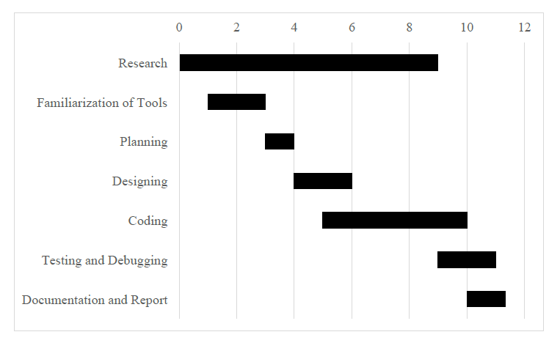
Timeline

Slide 10
Budget
Purpose | Expected Expenses (approx.)
Design | Rs. 40,000/-
Development | Rs. 3,00,000/-
Communication/IT | Rs. 30,000/-
Salary | Rs. 2,00,000/-
Total | Rs. 5,70,000/-
Total expense ................................................................................................ Rs.5,70,000/-
Total income (From one subscriber)………..……………………………………….Rs.2,500/-

Slide 11


System Requirement
Internet Connection
Web Browser
Mobile/Computer
Notes:
we evaluate our operator scale out approach with respect to time, load and threshold value
The test cases in our experiments are randomly generated. The followings are the details:
Parameters B, W, and D are randomly generated such that they are uniformly distributed within interval of [1, 10], [30, 60], and [40, 50], respectively. [B, W] The best case execution time and the worst case execution time of task i. D The relative deadline of
The execution time of an operator is assumed to be evenly distributed between interval of [B, W] i.e. f_{i}(t) = 1 ÷ (W_{i} - B_{i}).
G, L were assumed to be linear functions, i.e. G(t)= -ag*(t - D) in the range of [0, D] and L(t) = al*t. The gradient for G(t) and L(t), i.e.ag and al were randomly chosen from the interval of [4, 10] and [1, 5], respectively.
G(t) The profit TUF, which represents the profit accrued when a task is completed at time t. We assume G(t) is a non-increasing unimodal function before its deadline, i.e. G(t’i)>=G(t’j) if if t’i<=t’j and G(t) = 0 if t >=D;
L_{i}(T) :The penalty TUF, which represents the penalty, suffered when a task is discarded or aborted or exceeded deadline at time t. We assume L_{i}(T) is a non-decreasing unimodal function before its deadline, i.e. L_{i}(T’i) <=L_{i}(T’j) if t’i<=t’j , and a task is immediately discarded once it missed its deadline;
Operator execution Task release times intervals follow the exponential distribution with 𝜆 = 5.
The utility threshold 𝛿 is set 13075.579. This is average value of four operators. For each operator we run our experiment 60 times and then take average of generated value. There are four average values, each for one operator. Finally we again take average value of these four operator average value and we get 13075.579.
P_{i}(t): Size of stream tuples are generated randomly in the range of [128,1024] KB.
c_{i}(t): Cpu utilization is generated randomly in the range of [0, 1] for task i.
m_{i}(t): Memory utilization is also generated randomly in the range of [0, 1] for task i.
Each experiment was run 60 times and we report averaged measurements for more accuracy.

Slide 12
Expected Outcome
Dynamic Booking System.
Cheap and reliable compared to native method.
Clean and User Friendly UI.
Schedule Availability And Management
Notes:
we evaluate our operator scale out approach with respect to time, load and threshold value
The test cases in our experiments are randomly generated. The followings are the details:
Parameters B, W, and D are randomly generated such that they are uniformly distributed within interval of [1, 10], [30, 60], and [40, 50], respectively. [B, W] The best case execution time and the worst case execution time of task i. D The relative deadline of
The execution time of an operator is assumed to be evenly distributed between interval of [B, W] i.e. f_{i}(t) = 1 ÷ (W_{i} - B_{i}).
G, L were assumed to be linear functions, i.e. G(t)= -ag*(t - D) in the range of [0, D] and L(t) = al*t. The gradient for G(t) and L(t), i.e.ag and al were randomly chosen from the interval of [4, 10] and [1, 5], respectively.
G(t) The profit TUF, which represents the profit accrued when a task is completed at time t. We assume G(t) is a non-increasing unimodal function before its deadline, i.e. G(t’i)>=G(t’j) if if t’i<=t’j and G(t) = 0 if t >=D;
L_{i}(T) :The penalty TUF, which represents the penalty, suffered when a task is discarded or aborted or exceeded deadline at time t. We assume L_{i}(T) is a non-decreasing unimodal function before its deadline, i.e. L_{i}(T’i) <=L_{i}(T’j) if t’i<=t’j , and a task is immediately discarded once it missed its deadline;
Operator execution Task release times intervals follow the exponential distribution with 𝜆 = 5.
The utility threshold 𝛿 is set 13075.579. This is average value of four operators. For each operator we run our experiment 60 times and then take average of generated value. There are four average values, each for one operator. Finally we again take average value of these four operator average value and we get 13075.579.
P_{i}(t): Size of stream tuples are generated randomly in the range of [128,1024] KB.
c_{i}(t): Cpu utilization is generated randomly in the range of [0, 1] for task i.
m_{i}(t): Memory utilization is also generated randomly in the range of [0, 1] for task i.
Each experiment was run 60 times and we report averaged measurements for more accuracy.

Slide 13
Conclusion and Future Work
Online Payment gateway.
Tournament Organization And Management.
Recruitment, Transparency, Availability Of Skilled Players.
Live Feed And Stream of Tournaments and Important Matches.
Nepali language interface.
Event booking systems.

Slide 14
References
[1]. Reference 1
Futbox. 2019. Futbox Futsal Center I Indoor Soccer I Miami FL. [ONLINE] Available at: https://www.futbox.co/. [Accessed 16 July 2019].
TITLE. 2019. TITLE. [ONLINE] Available at: http://www.ibookcourt.com/. [Accessed 16 July 2019].
Flowchart Maker & Online Diagram Software. 2019. Flowchart Maker & Online Diagram Software. [ONLINE] Available at: https://www.draw.io/. [Accessed 16 July 2019].
FIFA.com. 2019. Futsal - FIFA.com. [ONLINE] Available at: https://www.fifa.com/futsal/. [Accessed 16 July 2019].
https://themeforest.net/user/dan_fisher. 2019. Welcome To UML Website!. [ONLINE] Available at: https://www.uml.org/. [Accessed 16 July 2019].

Slide 15


Slide 16


Thank You !!!

